Slide 1
Learning Objective
CFU
What will we learn today?
I will be able to determine the equation of a parabola
CFU
How will you know that you are successful?
Success Criteria
At the end of the lesson, I will be able to:
Determine the equation of a parabola

Slide 2
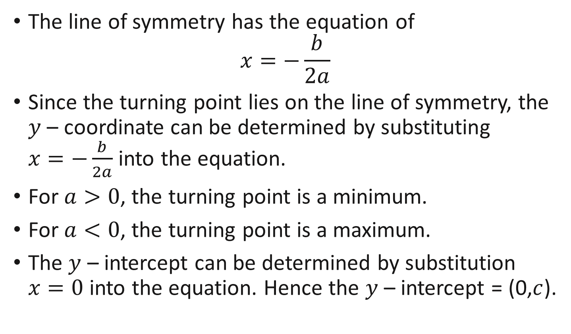
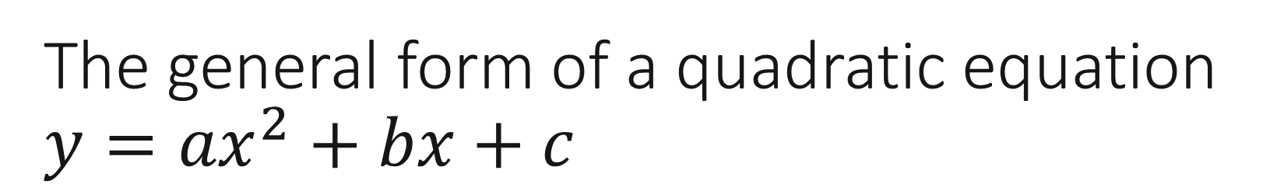
The general form of a quadratic equation $y={ax}^{2}+bx+c$
Concept Development
The line of symmetry has the equation of
$$x=−\frac{b}{2a}$$
Since the turning point lies on the line of symmetry, the $y$ – coordinate can be determined by substituting $x=−\frac{b}{2a}$ into the equation.
For $a>0$, the turning point is a minimum.
For $a<0$, the turning point is a maximum.
The $y$ – intercept can be determined by substitution $x=0$ into the equation. Hence the $y$ – intercept = (0,$c$).

Slide 3
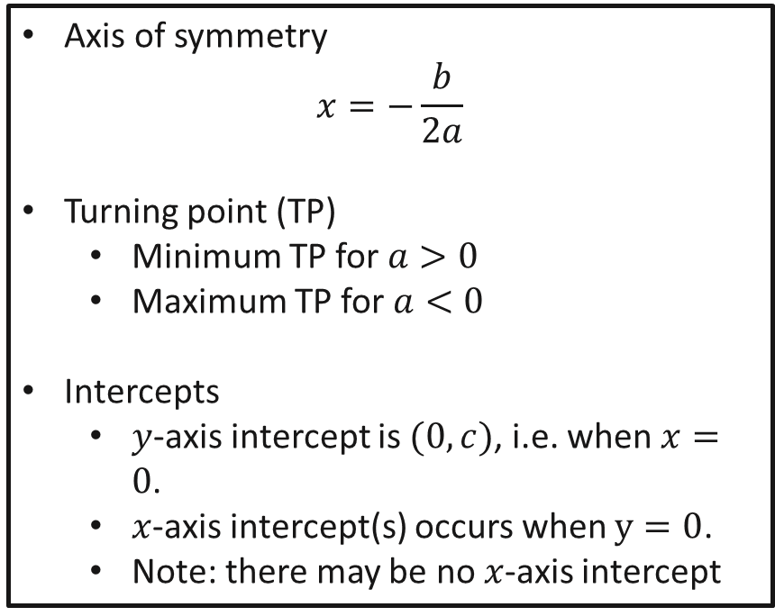

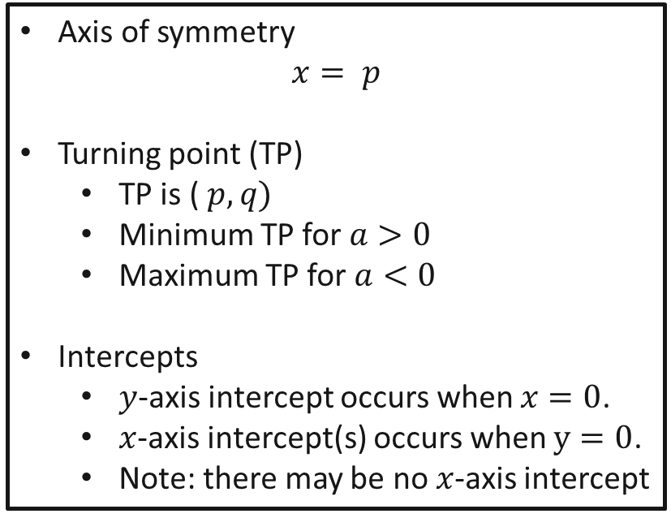

General form Turning Point form
Concept Development
Complete the Square
Expand
$$y= {ax}^{2}+bx+c$$
$$y= {a(x−p)}^{2}+q$$
Axis of symmetry
$$x=−\frac{b}{2a}$$
Turning point (TP)
Minimum TP for $a>0$
Maximum TP for $a<0$
Intercepts
$y$-axis intercept is $(0,c)$, i.e. when $x=0$.
$x$-axis intercept(s) occurs when $y=0$.
Note: there may be no $x$-axis intercept
Axis of symmetry
$$x= p$$
Turning point (TP)
TP is ($p, q)$
Minimum TP for $a>0$
Maximum TP for $a<0$
Intercepts
$y$-axis intercept occurs when $x=0$.
$x$-axis intercept(s) occurs when $y=0$.
Note: there may be no $x$-axis intercept

Slide 4
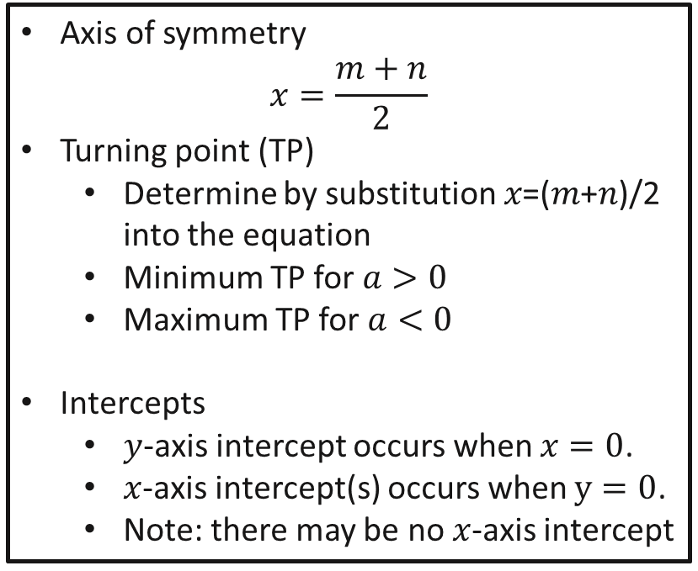

General form Factorised/ Root form
Concept Development
Factorise
Expand
$$y= {ax}^{2}+bx+c$$
$$y=a(x−m)(x−n)$$
Axis of symmetry
$$x=−\frac{b}{2a}$$
Turning point (TP)
Minimum TP for $a>0$
Maximum TP for $a<0$
Intercepts
$y$-axis intercept is $(0,c)$, i.e. when $x=0$.
$x$-axis intercept(s) occurs when $y=0$.
Note: there may be no $x$-axis intercept
Axis of symmetry
$$x=\frac{m+n}{2}$$
Turning point (TP)
Determine by substitution 𝑥=(𝑚+𝑛)/2 into the equation
Minimum TP for $a>0$
Maximum TP for $a<0$
Intercepts
$y$-axis intercept occurs when $x=0$.
$x$-axis intercept(s) occurs when $y=0$.
Note: there may be no $x$-axis intercept

Slide 5

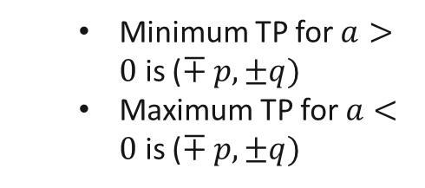





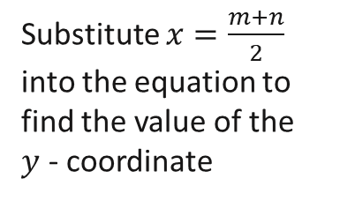

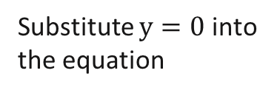






General Form
Turning Point Form
Root Form
$$y= {ax}^{2}+bx+c$$
$$y= {a(x±p)}^{2}±q$$
$$y=a(x±m)(x±n)$$
Axis of symmetry
$$x=−\frac{b}{2a}$$
$$x=\frac{m+n}{2}$$
$$x=∓ p$$
Turning point (TP)
$(x, y)$
substitute $x=−\frac{b}{2a}$ into the equation to find the value of the $y$ - coordinate
Minimum TP for $a>0$ is ($∓ p, ±q)$
Maximum TP for $a<0$ is ($∓ p, ±q)$
Substitute $x=\frac{m+n}{2}$
into the equation to find the value of the $y$ - coordinate
$y$ - intercept
$$(0,c)$$
substitute $x=0$ into the equation
Factorise into root form or use the quadratic formula
Substitute $y=0$ into the equation
$x=−m$ or $x=−n$
$x$ – intercept(s)
There may be TWO, ONE or ZERO $x$-axis intercept(s)
Change the general form into the tuning point form using completing the square to see clearly the horizontal and vertical translations of the parabola

Slide 6
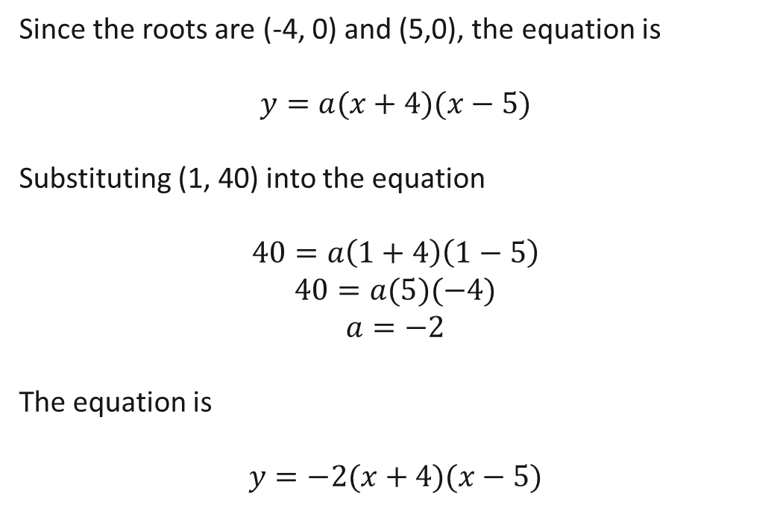
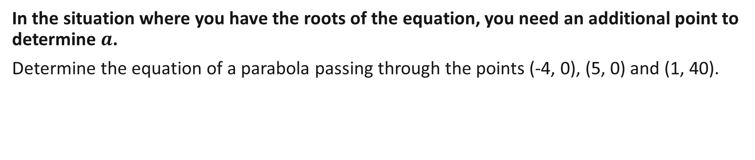
Guided Practice
In the situation where you have the roots of the equation, you need an additional point to determine $a$.
Determine the equation of a parabola passing through the points (-4, 0), (5, 0) and (1, 40).
Since the roots are (-4, 0) and (5,0), the equation is
$$y=a(x+4)(x−5)$$
Substituting (1, 40) into the equation
$$40=a\left(1+4\right)\left(1−5\right)$$
$$40=a(5)(−4)$$
$$a=−2$$
The equation is
$$y=−2(x+4)(x−5)$$

Slide 7
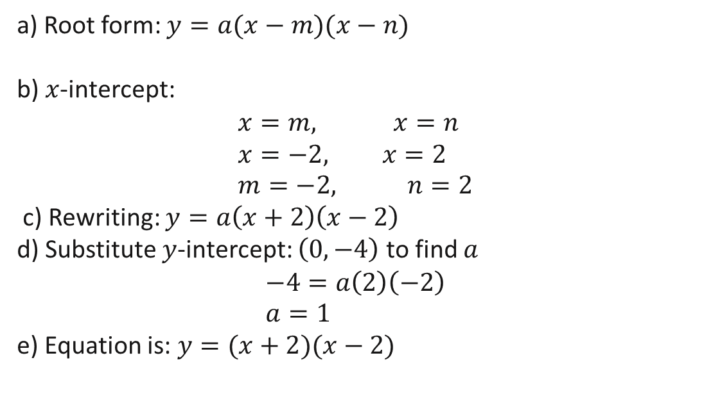
Guided Practice
Find the equation of the parabola that passes through the points $\left(2,0\right) , \left(−2, 0\right) and (0, −4)$
a) Root form: $y=a(x−m)(x−n)$
b) $x$-intercept: $$x=m, x=n \\ x=−2, x=2 \\ m=−2, n=2$$
c) Rewriting: $y=a\left(x+2\right)\left(x−2\right)$
d) Substitute $y$-intercept: $\left(0,−4\right)$ to find $a$
$$−4=a\left(2\right)\left(−2\right) \\ a=1$$ e) Equation is: $y=(x+2)(x−2)$

Slide 8
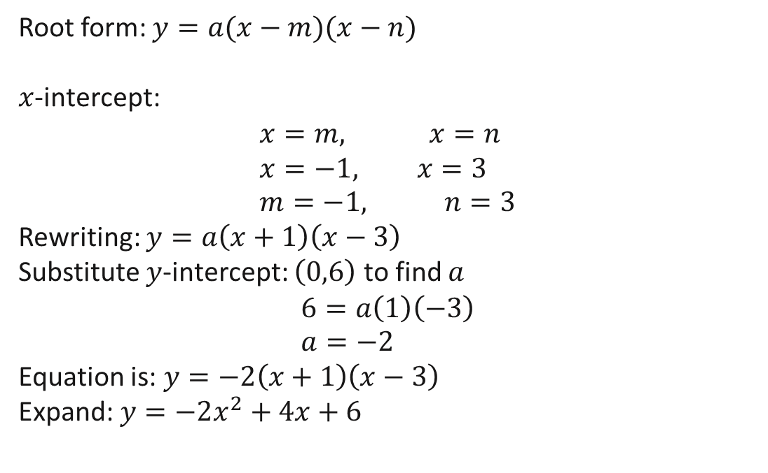
Guided Practice
Find the quadratic equation, in general form, that passes through the points $\left(−1,0\right) , \left(3, 0\right) and (0, 6)$
Root form: $y=a(x−m)(x−n)$
$x$-intercept: $$x=m, x=n \\ x=−1, x=3 \\ m=−1, n=3$$
Rewriting: $y=a\left(x+1\right)\left(x−3\right)$
Substitute $y$-intercept: $\left(0,6\right)$ to find $a$
$$6=a\left(1\right)\left(−3\right) \\ a=−2$$ Equation is: $y=−2\left(x+1\right)\left(x−3\right)$
Expand: $y=−2x^{2}+4x+6$

Slide 9
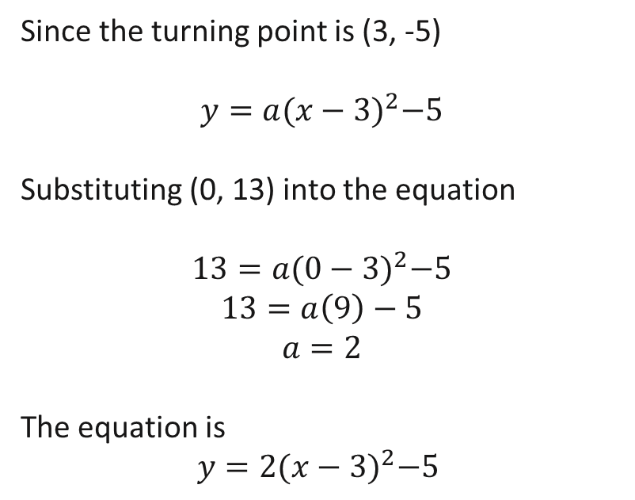
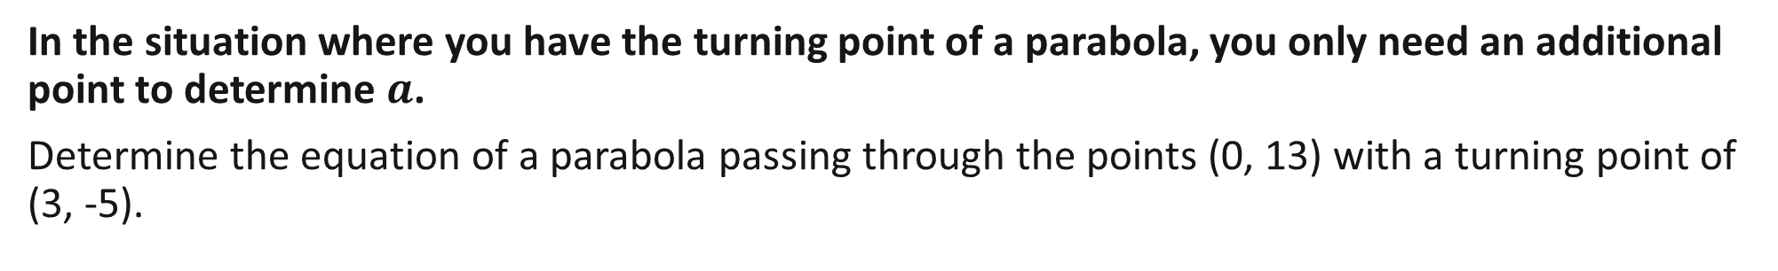
Guided Practice
In the situation where you have the turning point of a parabola, you only need an additional point to determine $a$.
Determine the equation of a parabola passing through the points (0, 13) with a turning point of (3, -5).
Since the turning point is (3, -5)
$$y=a{(x−3)}^{2}−5$$
Substituting (0, 13) into the equation
$$13=a{(0−3)}^{2}−5$$
$$13=a\left(9\right)−5$$
$$a=2$$
The equation is
$$y=2{(x−3)}^{2}−5$$

Slide 10
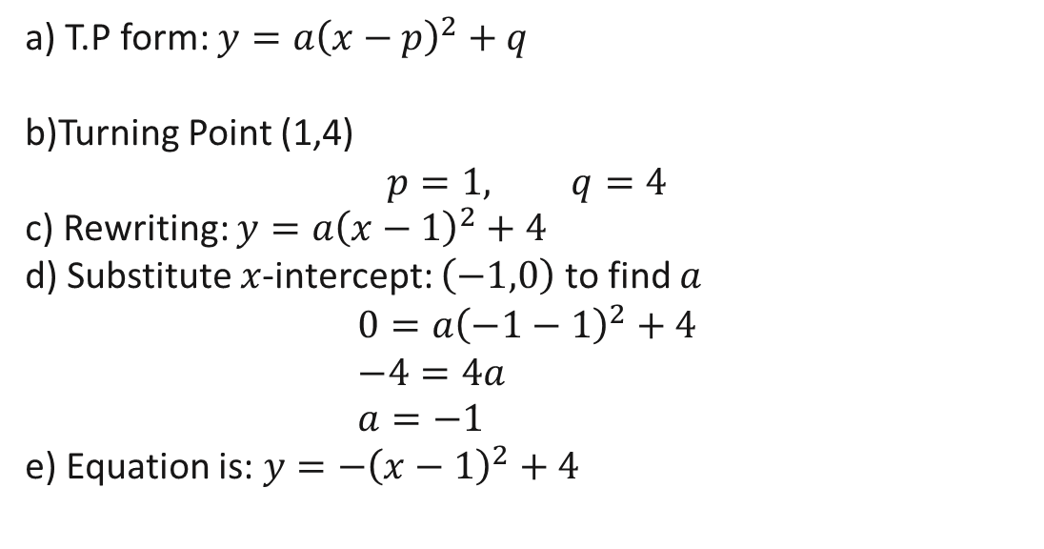
Guided Practice
Find the quadratic equation that passes has a turning point at $\left(1,4\right)$ and x-intercept at -1.
a) T.P form: $y=a{\left(x−p\right)}^{2}+q$
b)Turning Point (1,4) $$p=1, q=4$$ c) Rewriting: $y=a{\left(x−1\right)}^{2}+4$
d) Substitute $x$-intercept: $\left(−1,0\right)$ to find $a$
$$0=a{\left(−1−1\right)}^{2}+4 \\ −4=4a \\ a=−1$$ e) Equation is: $y=−{\left(x−1\right)}^{2}+4$

Slide 11
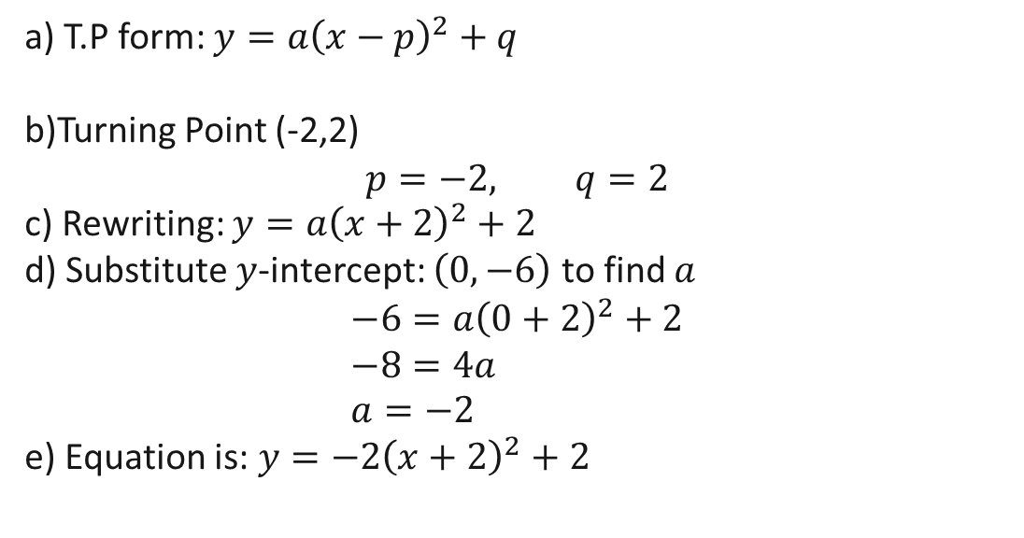
Guided Practice
Find the quadratic equation, in general form, that passes has a turning point at $\left(−2, 2\right)$ and y-intercept at -6.
a) T.P form: $y=a{\left(x−p\right)}^{2}+q$
b)Turning Point (-2,2) $$p=−2, q=2$$ c) Rewriting: $y=a{\left(x+2\right)}^{2}+2$
d) Substitute $y$-intercept: $\left(0, −6\right)$ to find $a$
$$−6=a{\left(0+2\right)}^{2}+2 \\ −8=4a \\ a=−2$$ e) Equation is: $y=−2{\left(x+2\right)}^{2}+2$

Slide 12
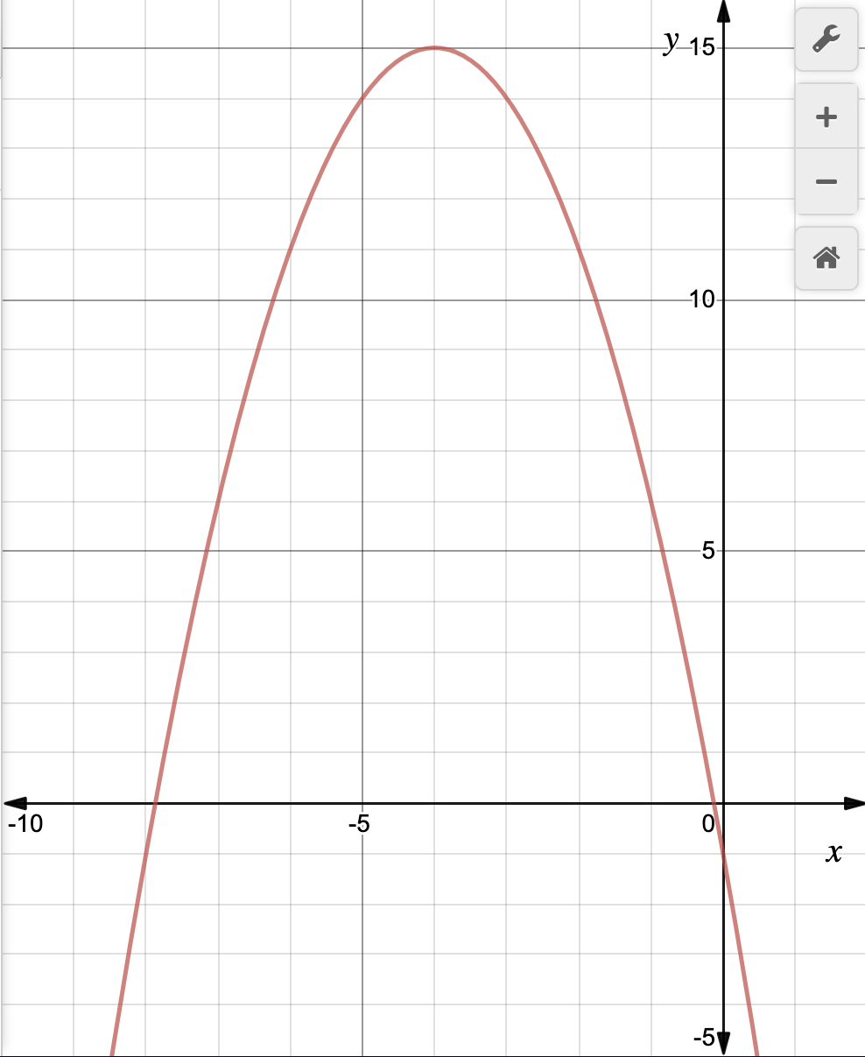
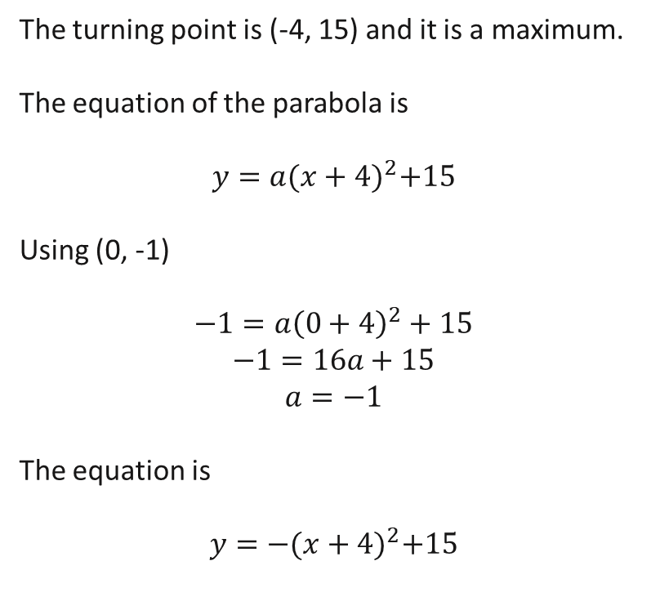
Guided Practice
(-4, 15)
Determine the equation of the parabola on the right.
The turning point is (-4, 15) and it is a maximum.
The equation of the parabola is
$$y=a{(x+4)}^{2}+15$$
Using (0, -1)
$$−1=a{\left(0+4\right)}^{2}+15$$
$$−1=16a+15$$
$$a=−1$$
The equation is
$$y=−{(x+4)}^{2}+15$$
(0, -1)

Slide 13

Cambridge Ex 3K Q1
A family of parabolas have rules of the form $y=ax^{2}+c$. Find the parabola in this family that passes through the points (-1,2) and (0,6), find the values of $a$ and $c$.
When $x=0, y=6$
$$6=0+c \\ c=6$$
When $x=−1, y=2$
$$2=a{\left(−1\right)}^{2}+6$$
$$a=−4$$
The equation is
$$y=−4x^{2}+6$$

Slide 14

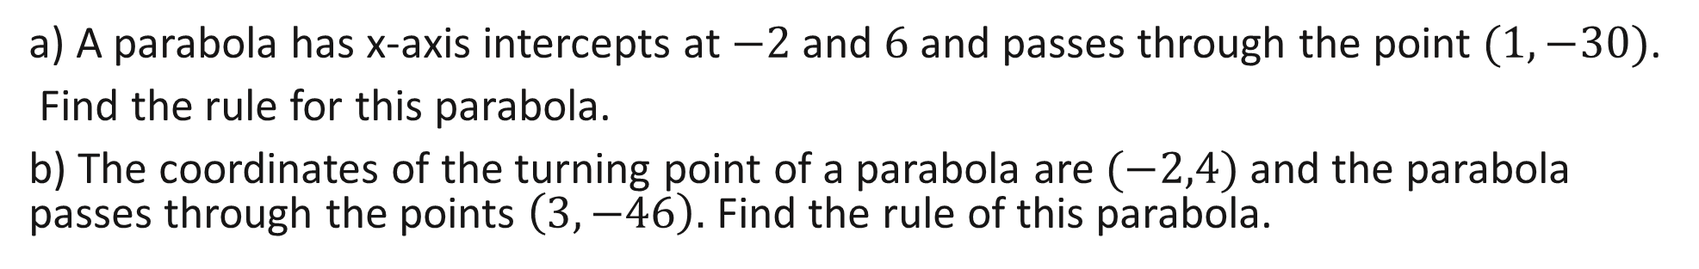

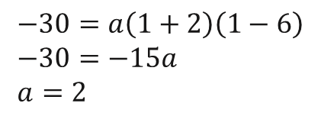


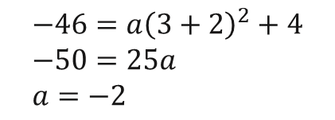


Cambridge Ex 3K Q3
a) A parabola has x-axis intercepts at $−2$ and $6$ and passes through the point $(1,−30)$.
Find the rule for this parabola.
b) The coordinates of the turning point of a parabola are $(−2,4)$ and the parabola passes through the points $\left(3,−46\right).$ Find the rule of this parabola.
a) $y=a(x+2)(x−6)$
b) $y=a{\left(x+2\right)}^{2}+4$
When $x=1, y=−30$
When $x=3, y=−46$
$$−30=a\left(1+2\right)\left(1−6\right) \\ −30=−15a \\ a=2$$
$$−46=a{\left(3+2\right)}^{2}+4 \\ −50=25a \\ a=−2$$
The rule is $y=2(x+2)(x−6)$
The rule is $y=−2{\left(x+2\right)}^{2}+4$

Slide 15

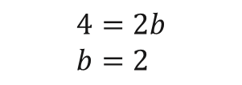









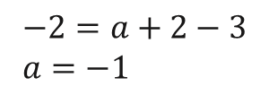
Cambridge Ex 3K Q3
c) A parabola passes through the points $\left(1,−2\right), (0,−3)$ and $(−1, −6)$ Find the rule of this parabola
$$y=ax^{2}+bx+c$$
When $x=1, y=−2$
$−2=a+b+c$ --------- (1)
When $x=0, y=−3$
$−3=c$ --------- (2)
When $x=−1, y=−6$
$−6=a−b−3$ --------- (3)
Subst. (2) into eqn. (1) and (3)
$−2=a+b−3$ -------- (4)
$−6=a−b−3$ --------- (5)
(4)-(5)
$$4=2b \\ b=2$$
$$−2=a+2−3 \\ a=−1$$
The rule is $y=−x^{2}+2x−3$

Slide 16
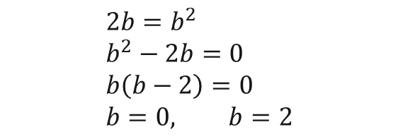
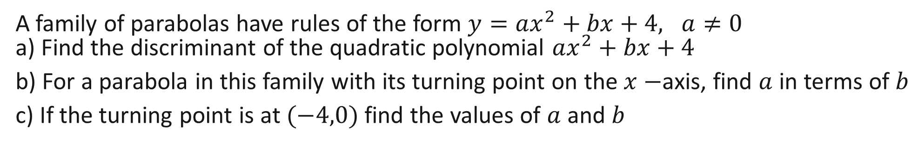

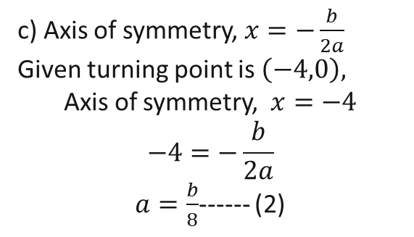
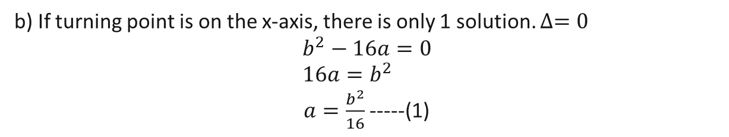
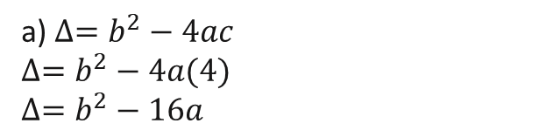
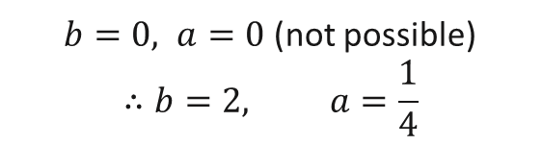
Cambridge Ex 3K Q2
A family of parabolas have rules of the form $y=ax^{2}+bx+4, a≠0$ a) Find the discriminant of the quadratic polynomial $ax^{2}+bx+4$
b) For a parabola in this family with its turning point on the $x−$axis, find $a$ in terms of $b$
c) If the turning point is at $(−4,0)$ find the values of $a$ and $b$
a) $∆=b^{2}−4ac$
$$∆=b^{2}−4a(4) \\ ∆=b^{2}−16a$$
b) If turning point is on the x-axis, there is only 1 solution. $∆=0$
$$b^{2}−16a=0 \\ 16a=b^{2}$$ $a=\frac{b^{2}}{16}$ -----(1)
c) Axis of symmetry, $x=−\frac{b}{2a}$
Given turning point is $\left(−4,0\right),$
Axis of symmetry, $x=−4$ $$−4=−\frac{b}{2a}$$ $a=\frac{b}{8}$------ (2)
Equate (1) and (2), $\frac{b}{8}=\frac{b^{2}}{16}$
$$2b=b^{2} \\ b^{2}−2b=0 \\ b\left(b−2\right)=0 \\ b=0, b=2$$
$b=0, a=0$ (not possible) $$∴b=2, a=\frac{1}{4}$$

Slide 17
Independent Practice
Cambridge Ex 3K

